Slide 1
Block Height Documentation
6.13.24 version 1.0

Slide 2
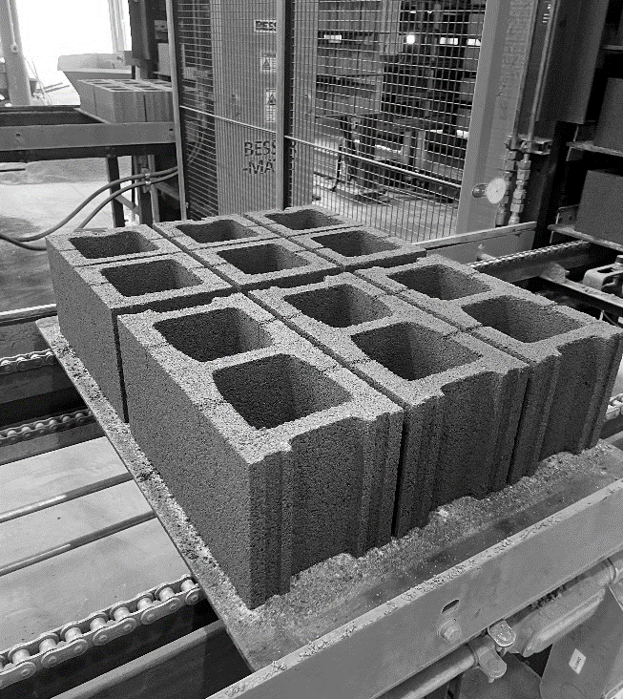
Assumptions and Prerequisite Skills
The computer is on and IntelliBatch 3.0 is open
Supplies Needed
1 acceptable pallet of blocks
1 acceptable steel pallet
Standard PPE Equipment
12-inch caliper
1 “Easton Block Height Checksheet”

Slide 3
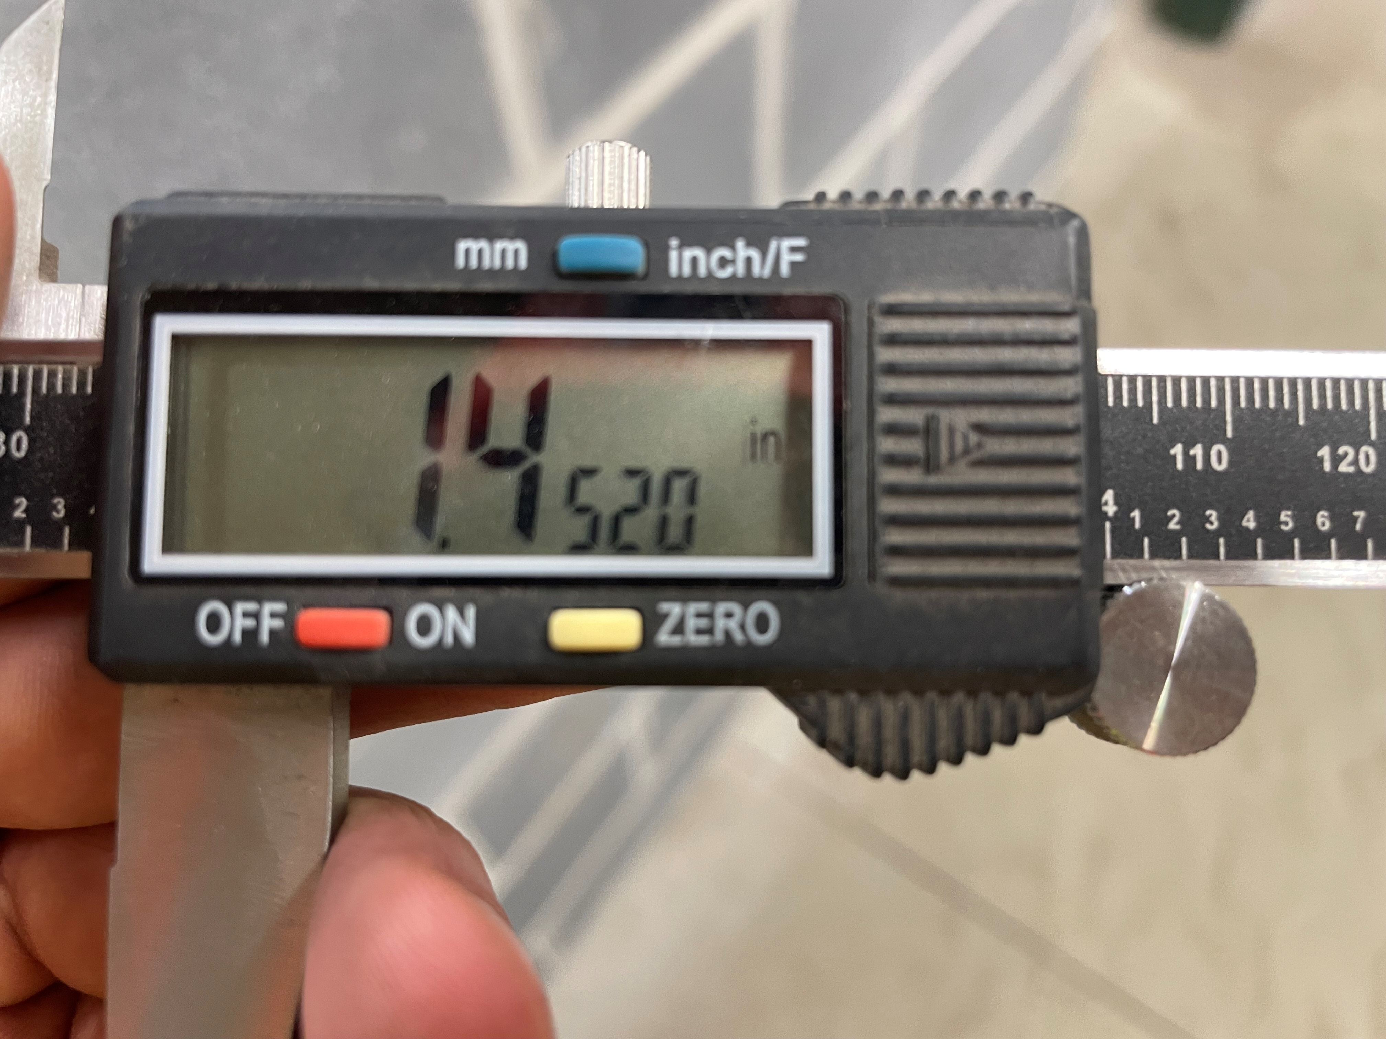
Procedure
Press the “on” button on the caliper. Check and make sure the caliper is set to inches (in). If it isn’t, press the “inch/F” button. Lastly, be sure to close the caliper and check that the value is 0 inches. If it isn’t, press the “zero” button to reset any offset distance (Figure 1)
Figure 1

Slide 4
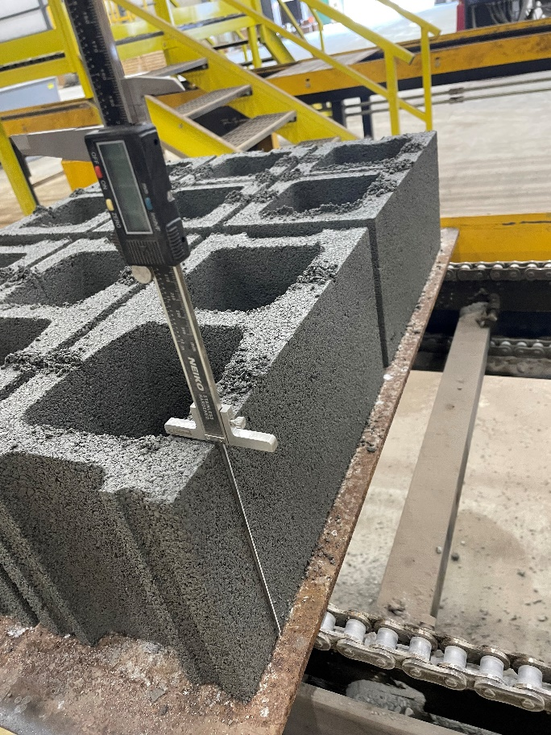
Procedure
2. Measure the height of the block by expanding the caliper until the end of the ruler is resting on top of the block, and the depth probe is resting on the surface of the pallet (Figure 2)
Figure 2

Slide 5
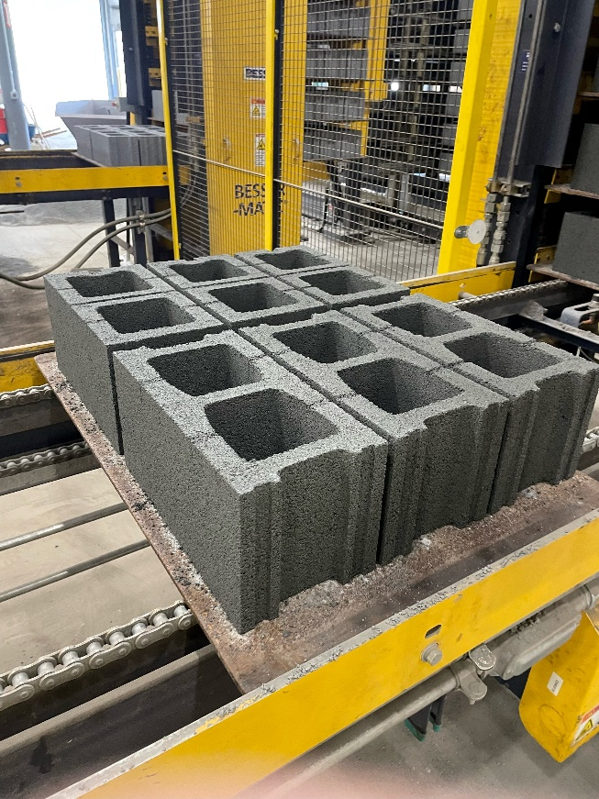
Procedure
Front right
Front left
3. While a pallet is going through the conveyor, measure each of the 5 parts required for documentation (Figure 3)
Middle
Back right
Back left
Figure 3

Slide 6
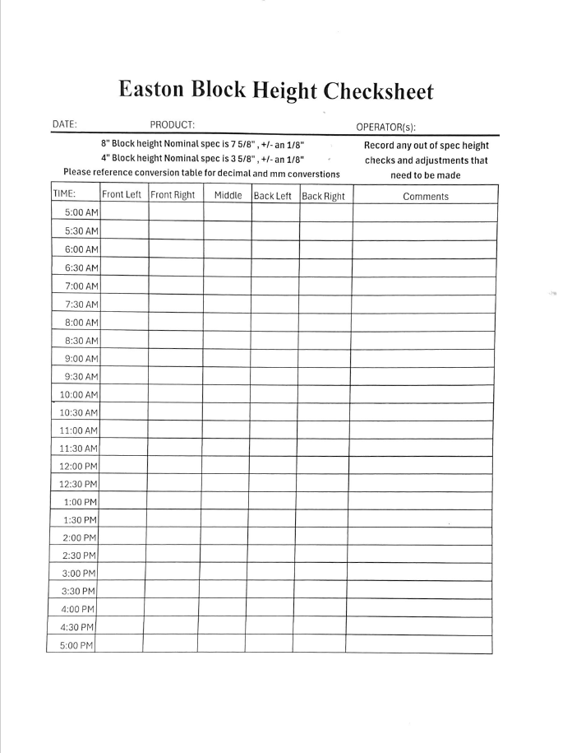
Procedure
4. Record each number in correspondence to the column label (Figure 4)
Figure 4

Slide 7
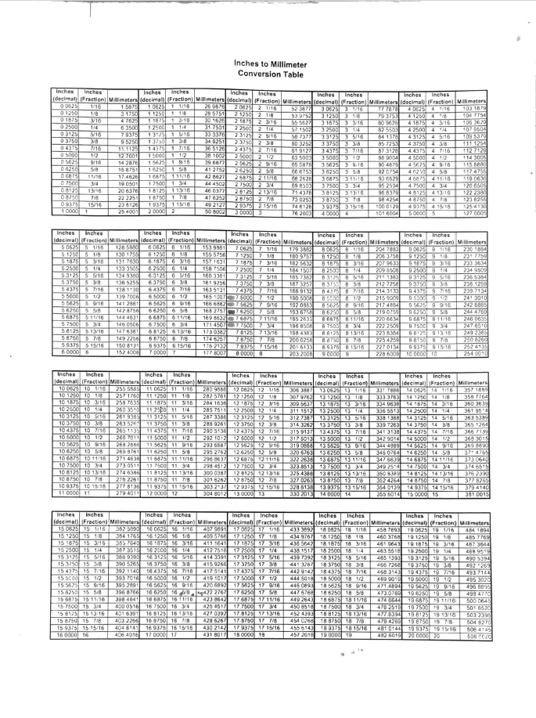
Procedure
5. Check and make sure each measurement is within (7.5– 7.8125 in). If the measurements fall in the “green” category, this meets acceptable standards, yellow means monitor closely and make minor adjustments to bring to acceptable standards. If a measurement falls in the red shaded category, repeat steps 2-4 on the next available pallet. If you get similar results, contact a supervisor for further instructions and write “failed test” in the “Comments” section from step 4
Figure 5

